Slide 1
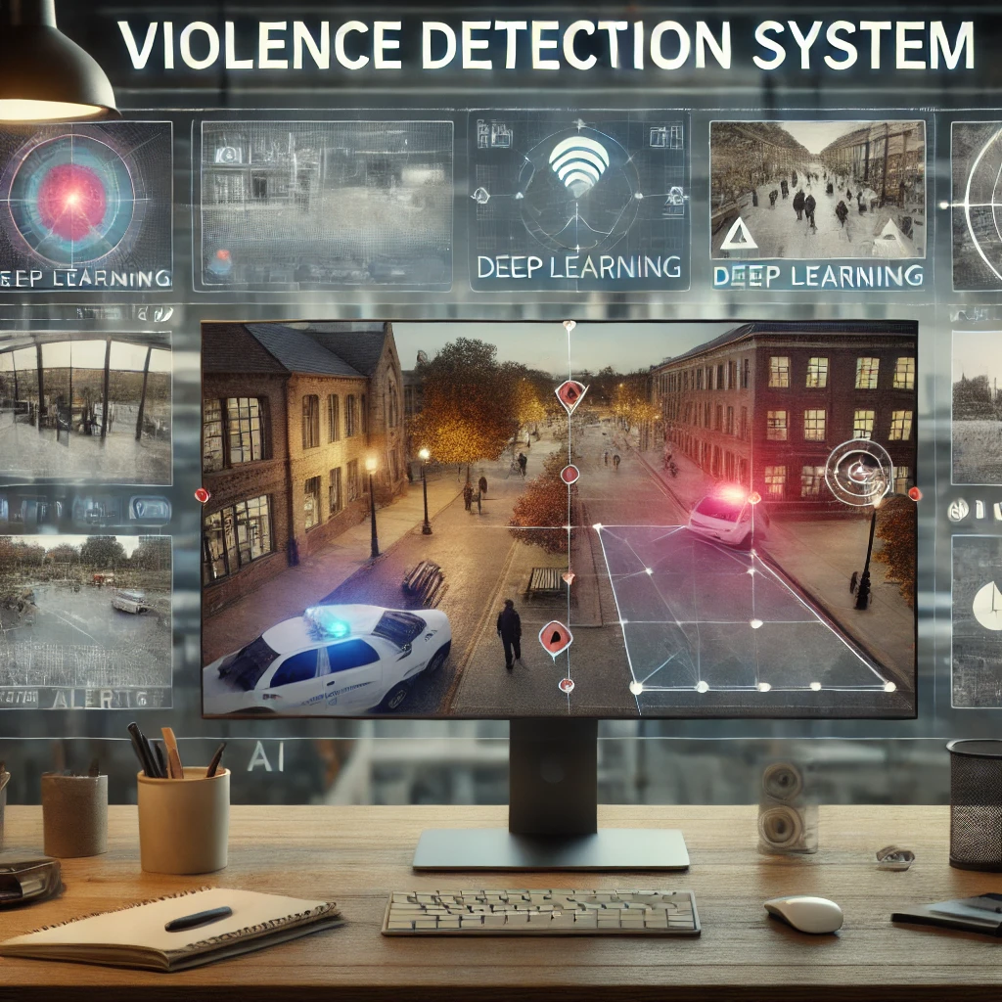
Group 3
Project Members
Raghav Agarwal
Anirudh Rao
Dhanush Bhargav
Guruksha Gurnani

Slide 2
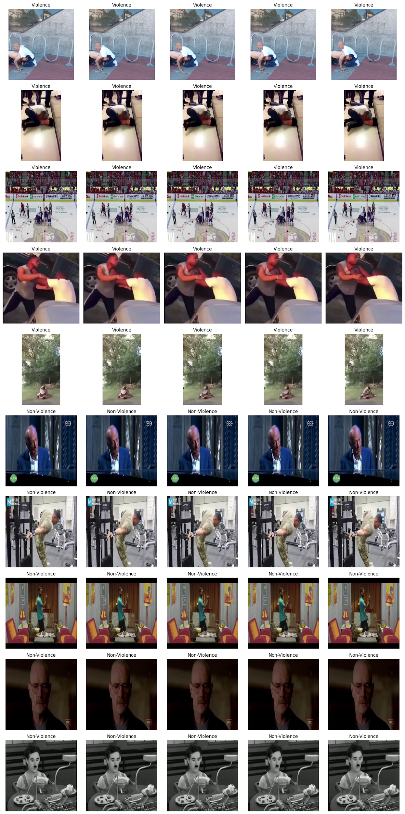
Visualization of Data
Violent Frames
Non-Violent Frames

Slide 3
Static Model

Slide 4
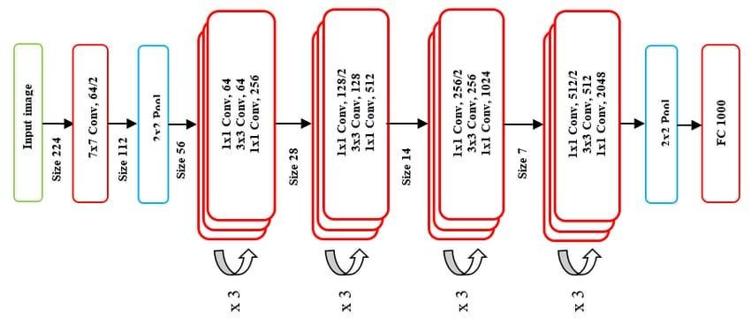
Model Architecture
Overview
Depth: 50 layers (consists of convolutional, batch normalization, ReLU activation, and pooling layers).
Key Innovation: The introduction of Residual Blocks, which allow the network to learn an identity mapping more effectively, mitigating the degradation problem observed in very deep networks.
Architecture Breakdown:
Initial convolution and max pooling layers.
4 stages of residual blocks with increasing depth.
Global average pooling layer.
Fully connected (FC) layer with softmax activation for final classification.
The ResNet-50 model is pre-trained on the ImageNet dataset, allowing for transfer learning, which helps in speeding up training and achieving high accuracy even with a smaller dataset.
Residual Block and Identity Mapping
The core component of ResNet-50 is the Residual Block, which can be expressed mathematically as:
y=F(x,{Wi​})+x
x: Input to the block.
F(x,{Wi}): Represents the residual function, which consists of convolutional layers with weights {Wi} and a non-linear activation function (such as ReLU).
y: Output of the block.
The addition of x (identity mapping) ensures that the gradient can flow easily through the network during backpropagation, reducing the vanishing gradient problem.

Slide 5
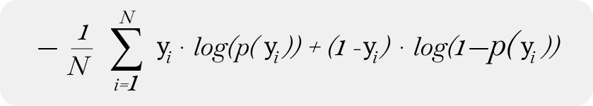
Training Algorithm
The model is trained using the Cross-Entropy Loss and the Adam (Adaptive Moment Estimation) optimizer. The combination of these techniques ensures efficient training and convergence.
Training Workflow
Forward Pass:
Input images are passed through the ResNet-50 model to produce class probabilities
.
Loss Calculation:
Compute the Cross-Entropy Loss between the predicted and actual labels.
Backward Pass:
Calculate gradients using backpropagation.
Weight Update:
Update the weights using the Adam optimizer.

Slide 6
Data Set Preparation
Frame Extraction From Videos
Each Video is parsed to extract one frame per second from the video
These frames are then stored and saved as .jpeg files in their respective directories and serve as the data for the Static model
DataLoader for Static Model
The ViolenceDataset Class collects all the frames we have extracted from the videos
The Labels are added to each frame based on the input directory it is read from
1→ Violence
0→ Non Violence
The ViolenceDataset is then Split into 80-20 Train and Test sets
The dataloader then fetches the Train and Test sets when needed for model training and evaluation

Slide 7
Static Model Results
Training Performance:
The training accuracy improves consistently across epochs, reaching 97.99% by the third epoch.
Training loss decreases with each epoch, indicating that the model is learning effectively.
Testing Performance:
The final Validation accuracy is 95.14%, which demonstrates good generalization performance.
The best test accuracy achieved is 96.00%

Slide 8
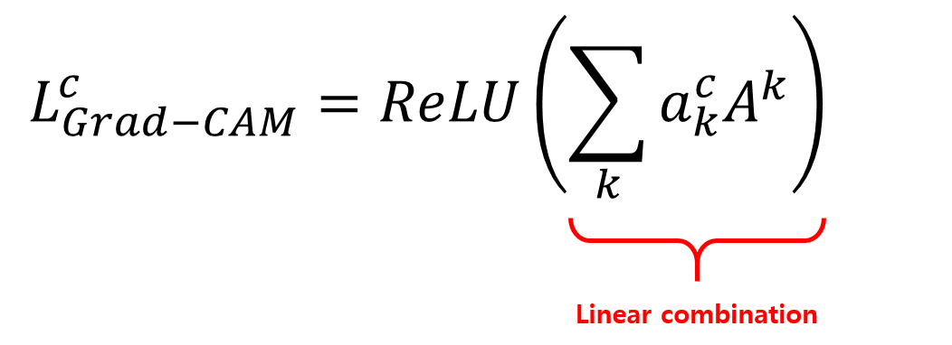
Inference through Grad-Cam
The Grad-CAM heatmap Lc for class c is computed as:
Where:
A^k​: Activation map from the target convolutional layer.
α^c.k​: Weights computed by performing global average pooling on the gradients of the target class ccc with respect to the activation map A^k
The ReLU function ensures that only positive influences are considered in the heatmap.
This equation helps identify which regions in the input image contribute most to the model's prediction for class c.

Slide 9
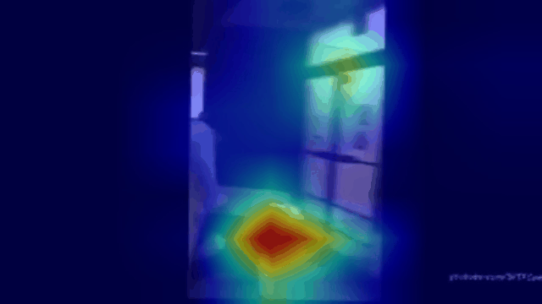
Inference Example

Slide 10
Temporal Model

Slide 11
Data Preparation
Split the dataset into train and test subsets in an 80:20 ratio.
From each video, select a random clip of 16 frames.
Apply transformations provided with R3D_18 model on PyTorch.

Slide 12
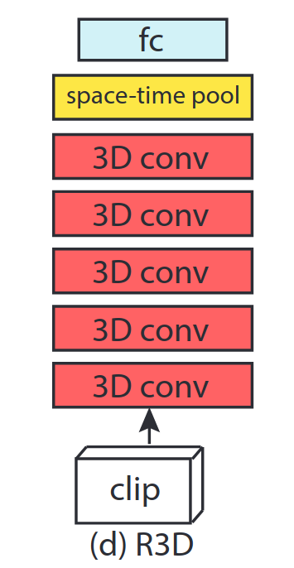
Model: R3D_18
Used ResNet3D_18 model with pre-trained weights from Kinetics400
Modified fully connected classifier to contain 1 neuron since binary classification
Added Sigmoid output activation
Fine-tuned with learning rate 0.001 for 10 epochs using binary cross entropy loss.

Slide 13
Results
Final model achieved 92.77% accuracy and 93.18% F1 score

Slide 14
Inference
Create multiple clips of 16 frames each from video
Run inference on each clip and output: violent or non-violent
Annotate video based on label of each clip to provide a real time indicator of violence in the video

Slide 15

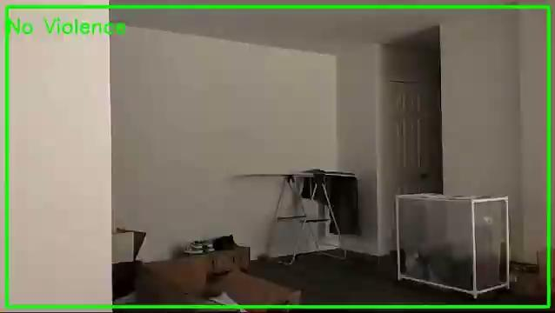
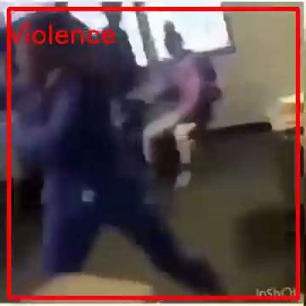
Inference Examples

Slide 16
Are you ready for a demo?

Slide 17
Thank you for your time,
Any questions?

